Slide 1
Tableau Desktop 10 Qualified Associate
Lesson 01—Exploring Tableau Interface

Slide 2



What’s In It For Me
At the end of this lesson, you will be able to:
Describe the components and terminologies of Tableau Describe Tableau Desktop Public edition, view, and data pages Explain the fields generated by Tableau automatically

Slide 3

Quick Recap: Why Tableau?
Meet Genelia, a data scientist. She wants to analyze the US employment by state as part of her new project.
What are the possible challenges that she might face?
She needs:
To handle a huge amount of data (big data)
To visualize the data
To generate reports in the correct format

Slide 4



Quick Recap: Why Tableau?
Genelia's colleague suggested her to use Tableau!
Tableau is a leading
business intelligence,
analytics, and
visualization application tool.
It helps to analyze data to learn and make better decisions.
It generates quick and correct reports on visualizations, which can be
customized according to our needs.
Tableau visualization on US employment

Slide 5
Download Tableau Desktop Public
Tableau Public latest version (10.x) can be downloaded from:
https://public.tableau.com/en-us/s/download

Slide 6
Introduction to Tableau Interface
Topic 1: Getting Started with Tableau Application
Opening Tableau Public Application
Exploring the start page
Exploring the data source page
Exploring Tableau workspace
Tableau files and folders

Slide 7





Getting Started with Tableau Application
OPENING TABLEAU APPLICATION
One of the following methods can be used to open the Tableau Public application:
Opening
Tableau
Application
Exploring the Start Page
Tableau
Select Start
Exploring
the Data
Source Page
OR
Programs
Double-click the Tableau public icon on your desktop
Exploring
Tableau
Workspace
Tableau
Tableau
Files and
Folders
This will take you to the Tableau start page.

Slide 8
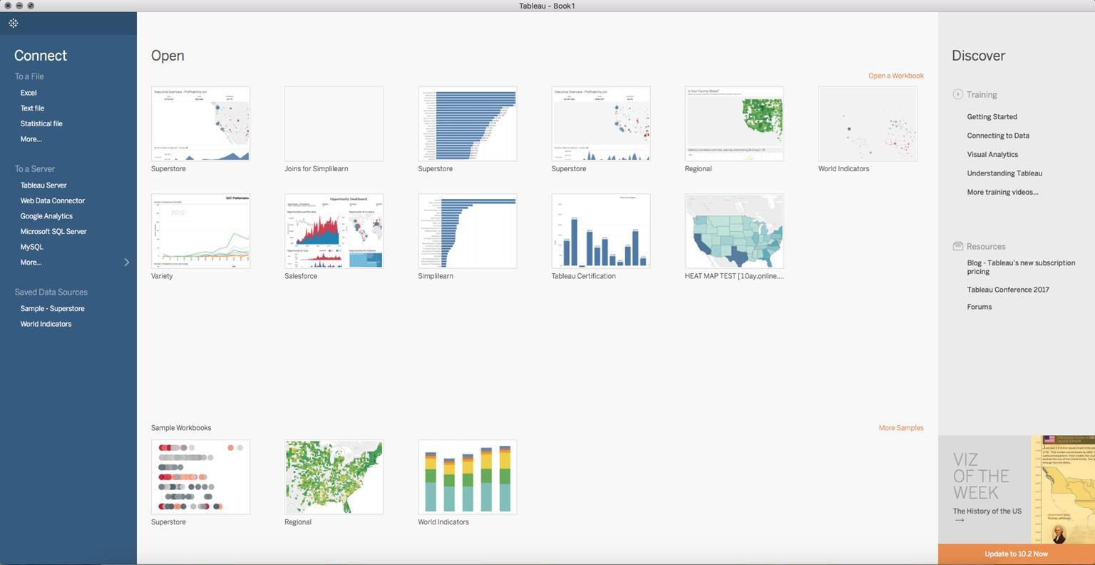
Getting Started with Tableau Application
EXPLORING THE START PAGE
Opening
Tableau
Application
Exploring the Start Page
The start page in Tableau Public is a central location. Through this, you can:
Connect to your data.
Access (through open section) most recently used workbooks.
Discover content produced by the Tableau community.
Exploring
the Data
Source Page
Exploring
Tableau
Workspace
Tableau
Files and
Folders

Slide 9
Getting Started with Tableau Application
EXPLORING THE START PAGE: CONNECT SECTION
Opening
Tableau
Application
Connect section lists different connectivity options (to a file, server, or saved data sources) offered by Tableau.
Exploring the Start Page
Exploring
the Data
Source Page
Exploring
Tableau
Workspace
Tableau
Files and
Folders

Slide 10

Getting Started with Tableau Application
EXPLORING THE START PAGE: OPEN SECTION
Opening
Tableau
Application
Exploring the Start Page
The open section provides access to recently opened or sample workbooks.
Exploring
the Data
Source Page
Exploring
Tableau
Workspace
Tableau
Files and
Folders

Slide 11
Getting Started with Tableau Application
EXPLORING THE START PAGE: DISCOVER SECTION
Opening
Tableau
Application
Exploring the Start Page
Exploring
the Data
Source Page
Discover section has links to Tableau community and helps users access training content, videos, tutorials, and latest visualizations.
Exploring
Tableau
Workspace
Tableau
Files and
Folders

Slide 12
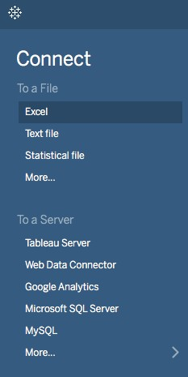
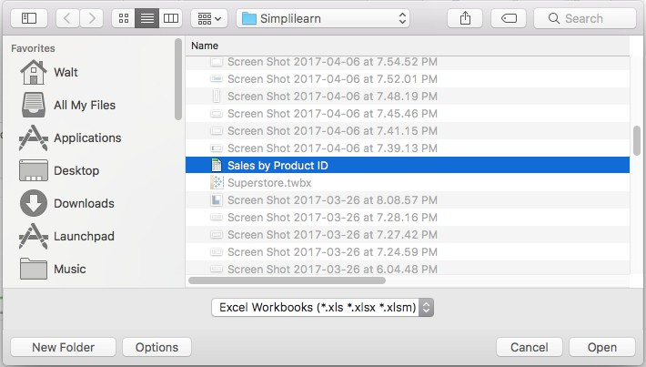
Getting Started with Tableau Application
CONNECTING TO DATA SOURCE
To start visualization, it’s important to connect to a data source.
Here is how you connect to an Excel data source:
Opening
Tableau
Application
Exploring the Start Page
Exploring
the Data
Source Page
Exploring
Tableau
Workspace
Tableau
Files and
Folders

Slide 13
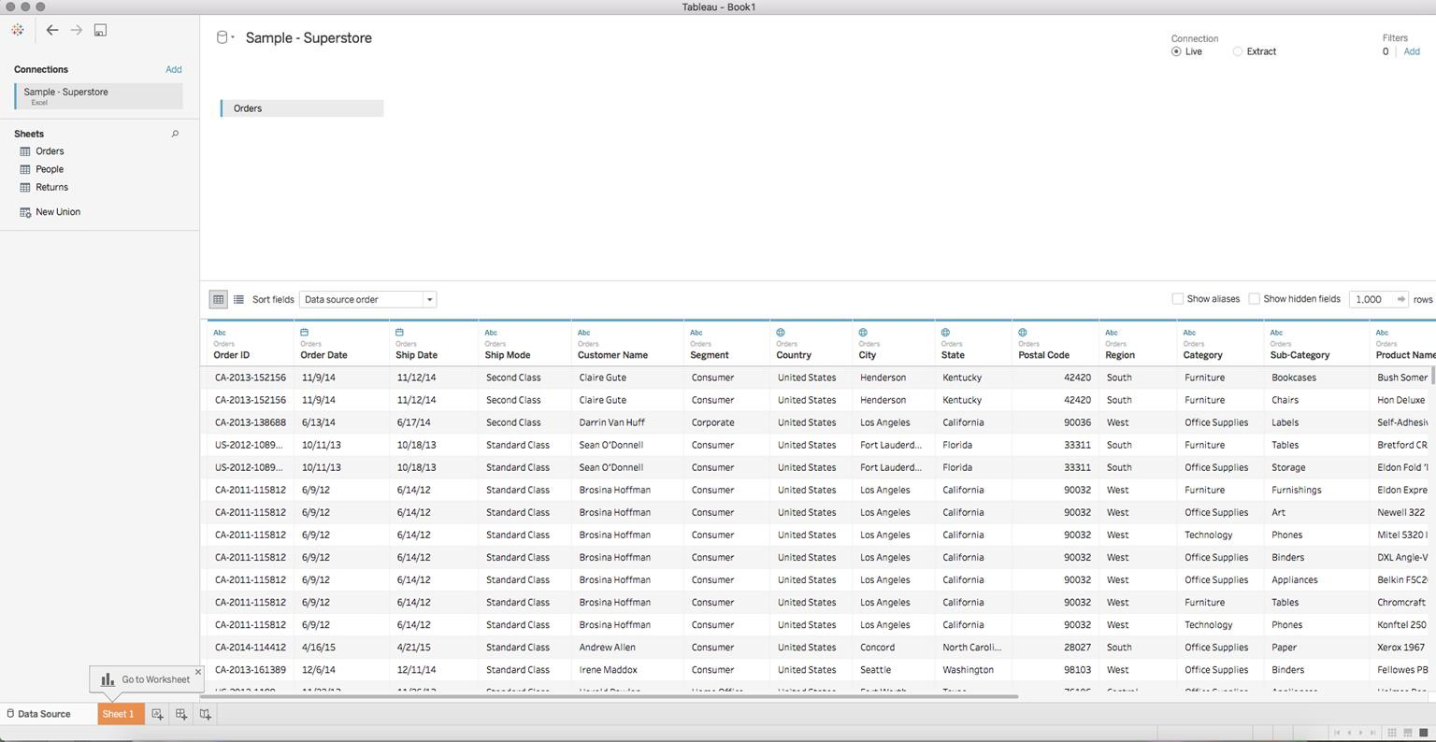
Getting Started with Tableau Application
EXPLORING THE DATA SOURCE PAGE
Tableau takes you to the Data Source page after you establish the initial connection to your data.
The Data Source page is used to make changes to the Tableau data sources.
Opening
Tableau
Application
Exploring the Start Page
Exploring
the Data
Source Page
Exploring
Tableau
Workspace
Tableau
Files and
Folders

Slide 14
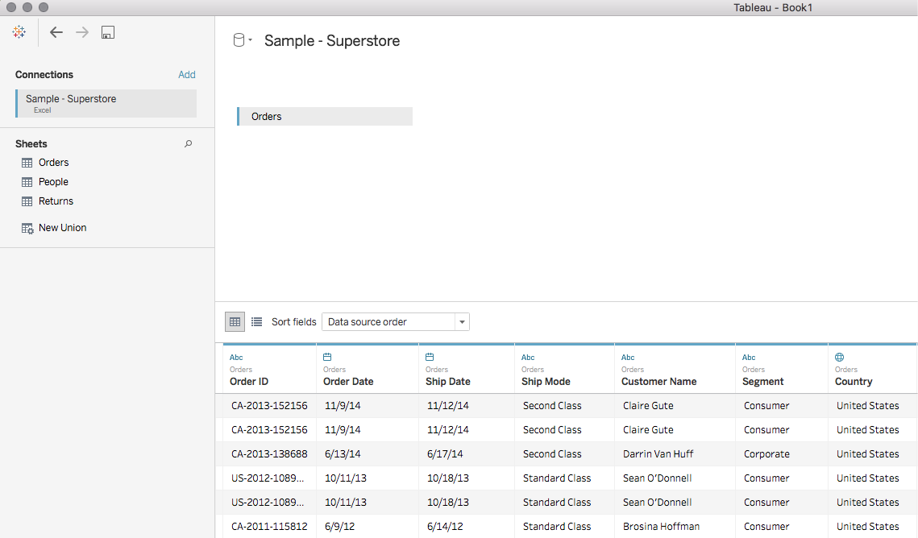

Getting Started with Tableau Application
EXPLORING THE DATA SOURCE PAGE
Opening
Tableau
Application
Exploring the Start Page
The left pane displays details about the data that Tableau Desktop is connected to.
Exploring
the Data
Source Page
Exploring
Tableau
Workspace
Tableau
Files and
Folders

Slide 15
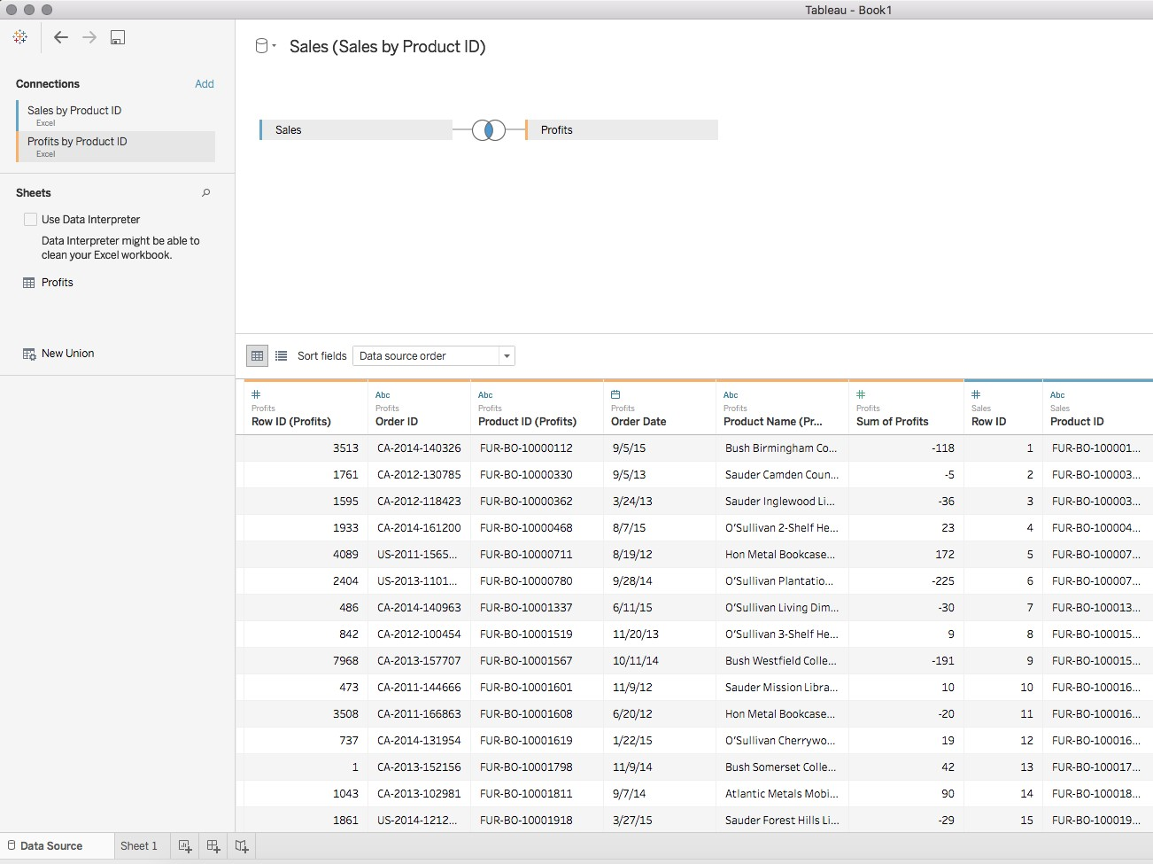


Getting Started with Tableau Application
EXPLORING THE DATA SOURCE PAGE
Opening
Tableau
Application
Exploring the Start Page
Join area defines the type of join between the tables in the data source.
Exploring
the Data
Source Page
Exploring
Tableau
Workspace
Tableau
Files and
Folders
Data source filters can be defined to restrict data coming from data source.

Slide 16

Getting Started with Tableau Application
EXPLORING THE DATA SOURCE PAGE
Opening
Tableau
Application
Exploring the Start Page
Exploring
the Data
Source Page
Exploring
Tableau
Workspace
Preview pane gives a quick view of the data and allows general modification.
Tableau
Files and
Folders

Slide 17
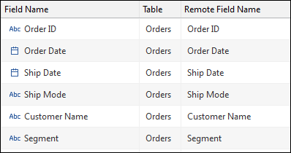

Getting Started with Tableau Application
EXPLORING THE DATA SOURCE PAGE
Opening
Tableau
Application
Exploring the Start Page
Exploring
the Data
Source Page
Exploring
Tableau
Workspace
Metadata area displays the fields as rows, which will help you quickly examine the structure of the data source.
Tableau
Files and
Folders

Slide 18
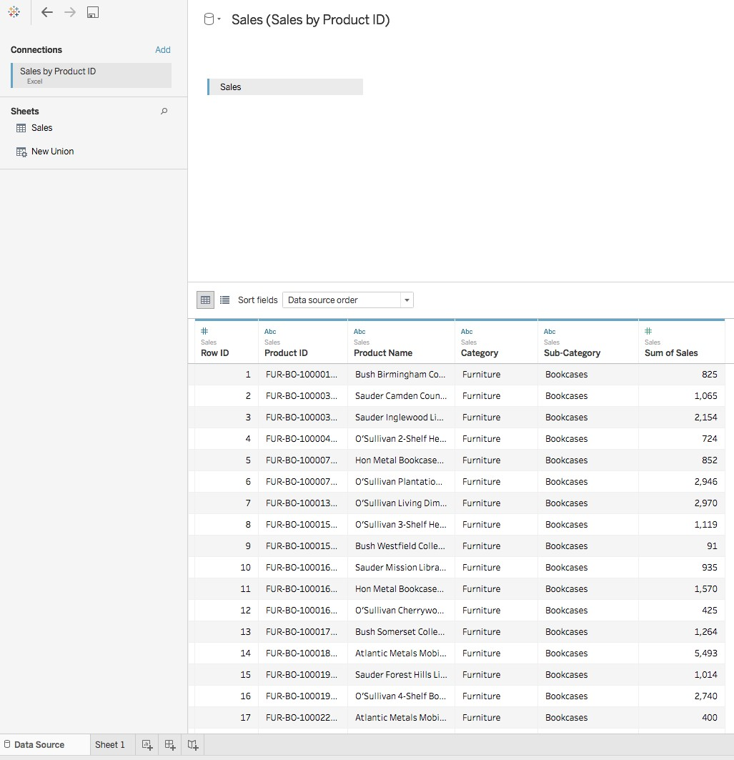
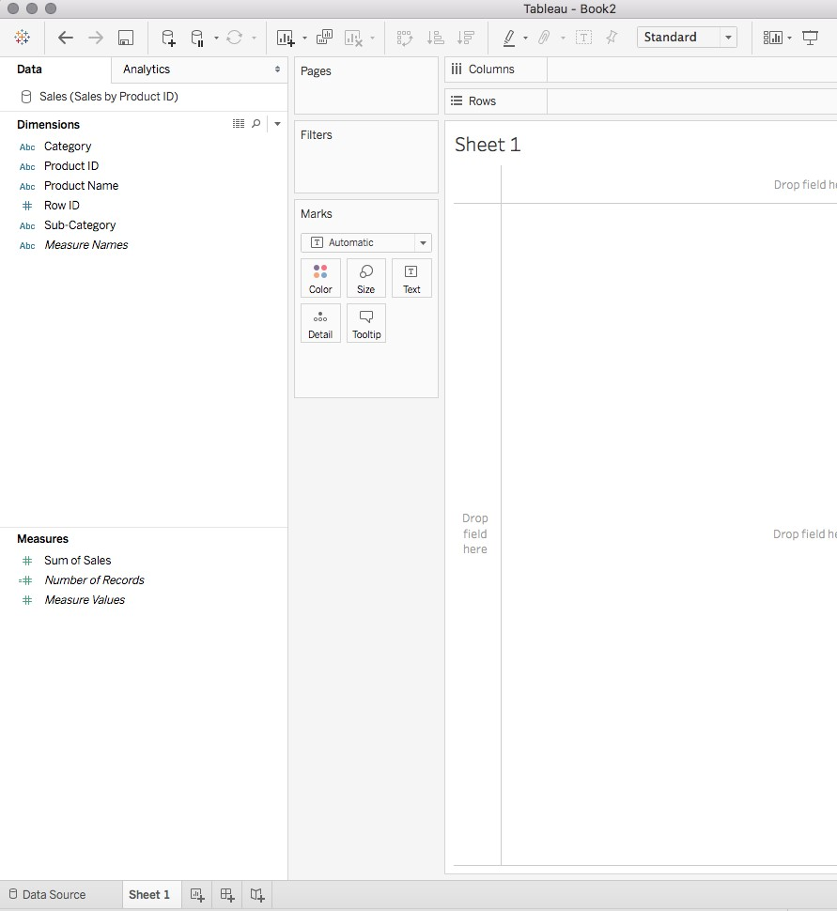
Getting Started with Tableau Application
EXPLORING THE DATA SOURCE
After reviewing the data source page to confirm the data was interpreted correctly, click the “Sheet1” tab to open
a worksheet in the Tableau workspace. The data source will appear in the data pane:
PAGE
Opening
Tableau
Application
Exploring the Start Page
Shows the
data layout
Exploring
the Data
Source Page
Exploring
Tableau
Workspace
Tableau
Files and
Folders

Slide 19
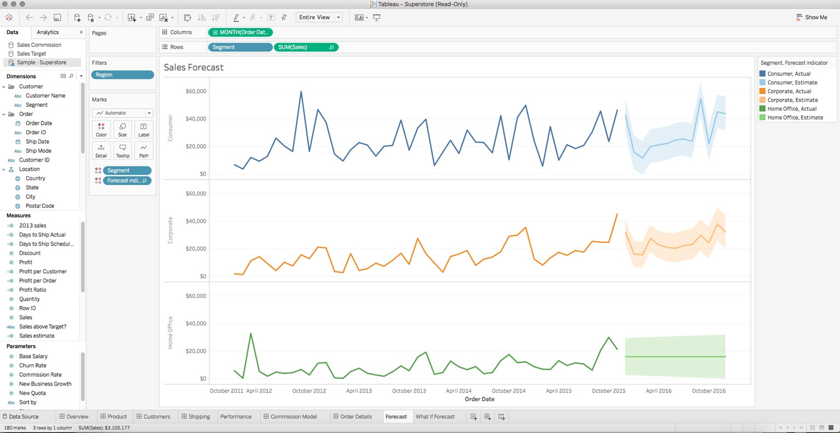
Getting Started with Tableau Application
EXPLORING TABLEAU WORKSPACE
The Tableau workspace consists of menus, the data pane, a toolbar, cards and shelves, and a few sheets, including worksheets, dashboards, or stories.
Opening
Tableau
Application
Exploring the Start Page
Exploring
the Data
Source Page
Data pane contains data sets from different data sources.
Exploring
Tableau
Workspace
Tableau
Files and
Folders

Slide 20
Getting Started with Tableau Application
EXPLORING TABLEAU WORKSPACE: TOOLBAR
The toolbar on Tableau workspace
Opening
Tableau
Application
provides quick access controls for
commonly used functions:
Undo and Redo
Save
Add data source
Add worksheet (or dashboard, story)
Duplicate sheet
Clear sheet (or formatting and other options)
Pause auto updates
Run update
Swap
Sort ascending/descending
Group members
Show mark labels
Show/hide cards
View options
Fix axes
Highlight
Presentation mode
Exploring the Start Page
Exploring
the Data
Source Page
Exploring
Tableau
Workspace
Tableau
Files and
Folders

Slide 21

Getting Started with Tableau Application
EXPLORING TABLEAU WORKSPACE: CARDS
Opening
Tableau
Application
Exploring the Start Page
Exploring
the Data
Source Page
Cards are containers for shelves, legends, and other controls.
V
Exploring
Tableau
Workspace
Tableau
Files and
Folders
Properties of cards are based on its type. For example, Marks card controls the mark properties.

Slide 22
Getting Started with Tableau Application
EXPLORING TABLEAU WORKSPACE: CARDS
Opening
Tableau
Application
Some cards are dynamic and are visible depending upon mark/view type:
Cards visible by default:
Cards that can be enabled
using the toolbar action:
Exploring the Start Page
Exploring
the Data
Source Page
Columns
Rows
Pages
Filters
Marks
Legend
Parameters
Map Legend
Measure Values Shelf
Title
Caption
Summary
Exploring
Tableau
Workspace
Tableau
Files and
Folders

Slide 23

Getting Started with Tableau Application
EXPLORING TABLEAU WORKSPACE: VIEW
Opening
Tableau
Application
Exploring the Start Page
Exploring
the Data
Source Page
The actual visualization created by placing dimensions and measures on shelves is visible in the view.
Exploring
Tableau
Workspace
Tableau
Files and
Folders

Slide 24

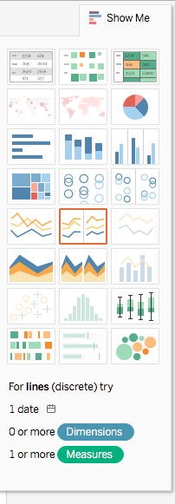
Getting Started with Tableau Application
EXPLORING TABLEAU WORKSPACE: SHOW ME
Opening
Tableau
Application
Exploring the Start Page
Show Me section contains all possible visualizations in Tableau.
Depending on the Dimensions and Measures selected, it highlights the allowed views.
Based on the current view, it highlights the alternative views.
Exploring
the Data
Source Page
Exploring
Tableau
Workspace
Tableau
Files and
Folders

Slide 25
Getting Started with Tableau Application
TABLEAU FILES AND FOLDERS
Different file types associated with Tableau are:
Opening
Tableau
Application
Data Extract (.tde)
Extract files are a local copy of a subset or entire data source. Use extracts to share data, work offline, and improve database performance.
Workbooks (.twb)
Workbooks hold one or more worksheets and zero or more dashboards and stories.
Exploring the Start Page
Exploring
the Data
Source Page
Bookmarks contain a single
Data Source (.tds)
Data source files do not contain the actual data but the information necessary to connect to the data source.
^{Bookmarks} worksheet and are used as an easy
(.tbm)
way to quickly share your work.
Exploring
Tableau
Workspace
Tableau
Files and
Folders
A packaged workbook is a single
A packaged data source is a zip file that contains the data source file (.tds) described above as well as local file data sources such as Extract files (.tde), text files, Excel files, Access files, and local cube files.
Packaged
zip file that contains a workbook
Packaged Data Source (.tdsx)
Workbooks along with any supporting local
(.twbx)
file data sources and
background images.

Slide 26
Demo—Getting Started with Tableau Application
Demonstrate how to create a workbook and vertical bar chart, connect to saved data source, add a return table, and save the workbook

Slide 27
Introduction to Tableau Interface
Topic 2: Components of View Section

Slide 28
Components of View Section
A view consists of several sections:
Field labels Title
Marks Cards
Legends Captions
Values Headers
Some of the sections are specific to the visualization selected.

Slide 29
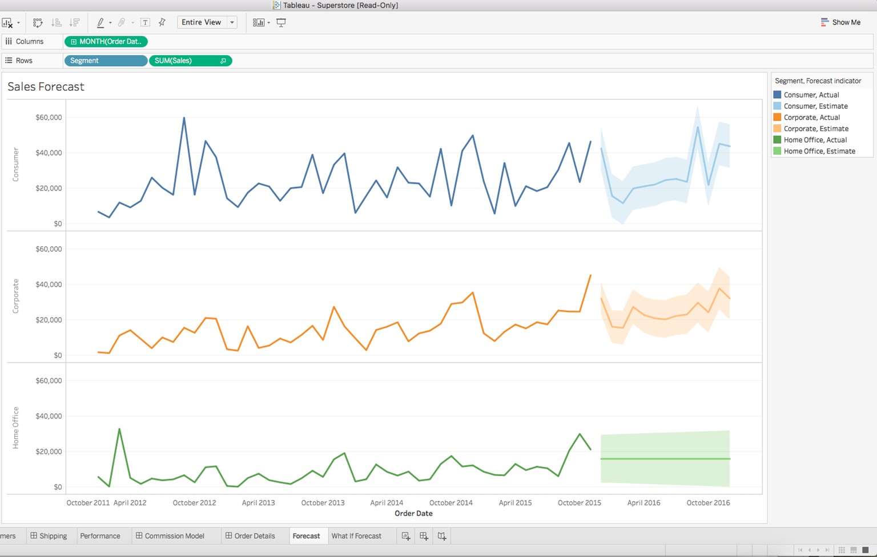

Components of View Section
FIELD LABELS
Field labels
Title
Marks card
Legends
Captions
Values
Headers
Field labels display the members of the field.

Slide 30
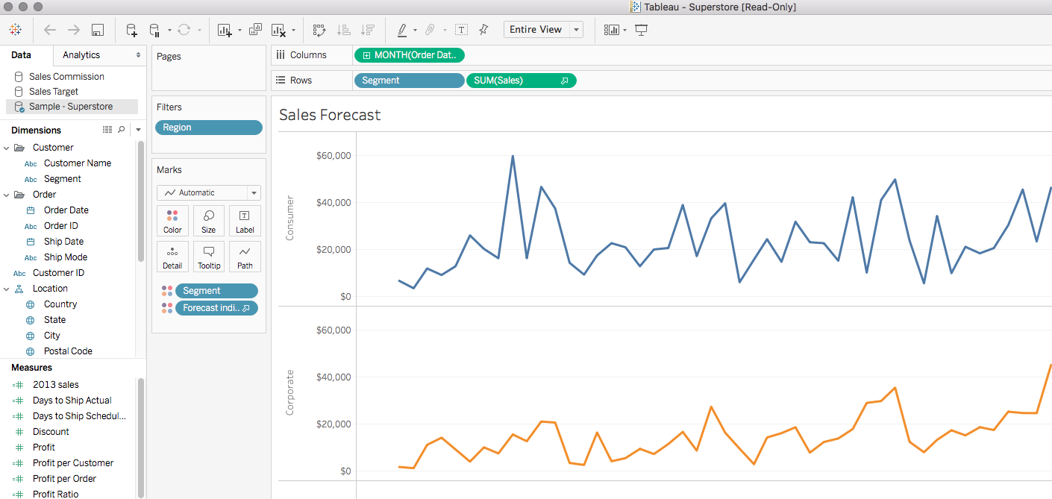

Components of View Section
TITLE
Field labels
Title
Marks card
Legends
Captions
Values
Headers
Title displays the title of the worksheet.

Slide 31
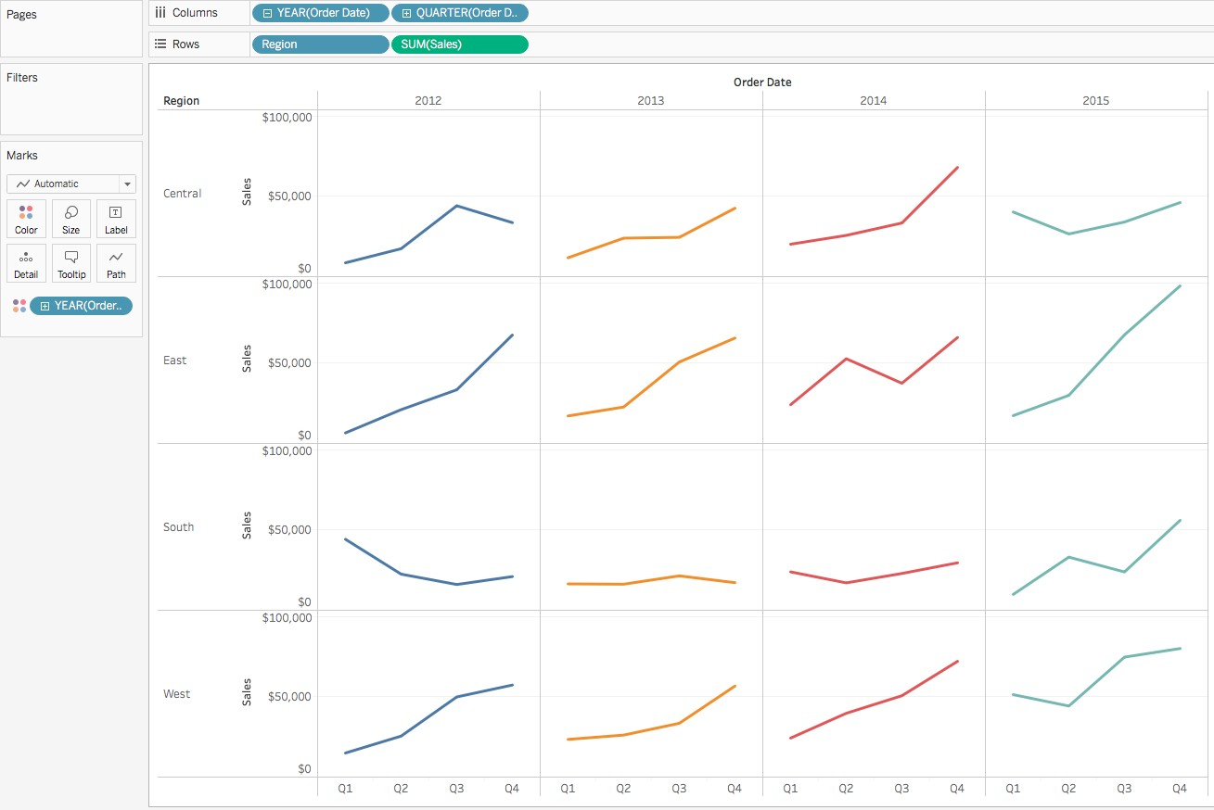
Components of View Section
MARKS CARDS
Field labels
Title
Marks card
Legends
Captions
Values
Headers
Marks cards are the primary means to express dimensions and measures in visualizations.

Slide 32
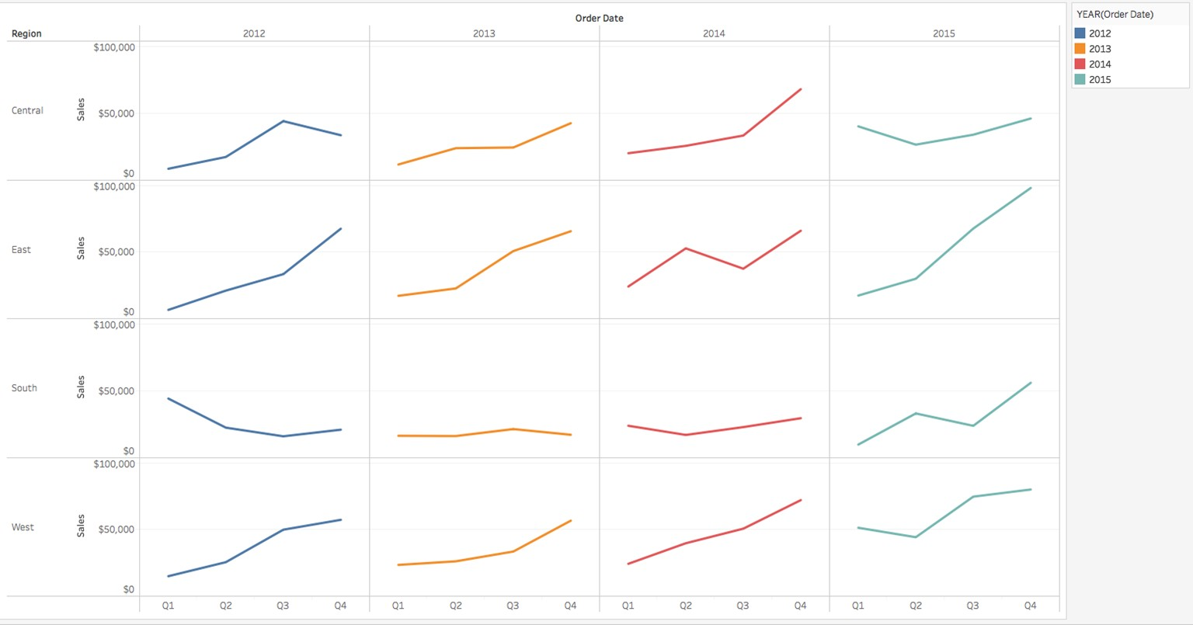

Components of View Section
LEGENDS
Field labels
Title
Marks card
Legends
Captions
Values
Headers
Legends indicate how the view is encoded in relation to your data; they define the color coding of the marks, which can be customized.

Slide 33
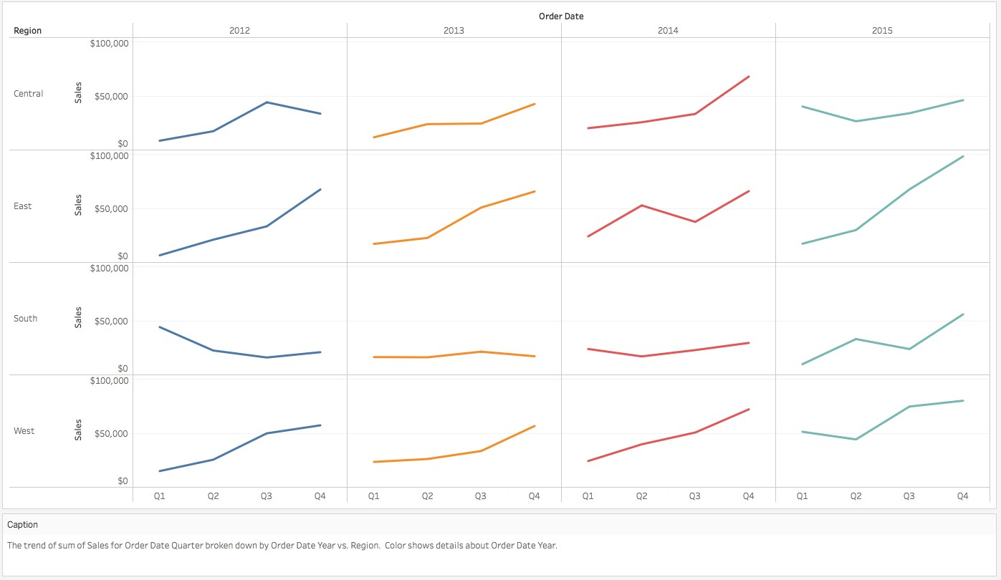

Components of View Section
CAPTIONS
Field labels
Title
Marks card
Legends
Captions
Values
Headers
Captions are auto- generated based on the view and describe visualization based on the shelf data.

Slide 34
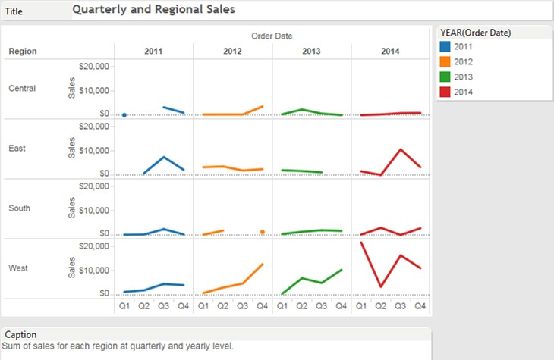
Components of View Section
VALUES
Field labels
Title
Marks card
Legends
Captions
Values
Headers
Values represent the numerical data contained in a Measure. It is represented as a continuous axis.

Slide 35
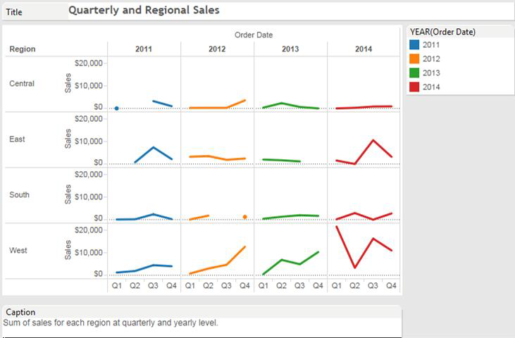

Components of View Section
HEADERS
Field labels
Title
Marks card
Legends
Captions
Values
Headers
Headers show the member names of each field on the row shelf and column shelf.

Slide 36
Introduction to Tableau Interface
Topic 3: Data Terminology and Definitions
Data Types
Data Roles

Slide 37

Data Types
All fields in a data source have a data type. The data type reflects the kind of information stored in that field.

Slide 38
Data Types
Text values: Alphanumeric data and
strings are Text data types.
Example: “Books,” “CA-2013-151654”
abc
All fields in a data source have a data type. The data type reflects the kind of information stored in that field.

Slide 39

Data Types
Text values: Alphanumeric data and
strings are Text data types.
Example: “Books,” “CA-2013-151654”
abc
All fields in a data source have a data type. The data type reflects the kind of information stored in that field.
Date values: Strings matching a date format are considered Dates. Example: “01/23/2015,” “Jan 2015”

Slide 40
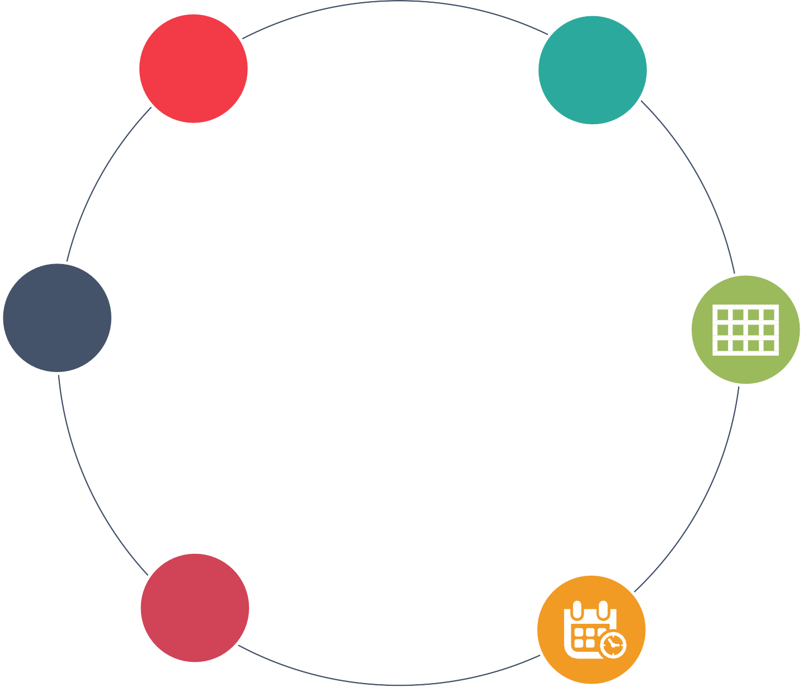
Data Types
Text values: Alphanumeric data and
strings are Text data types.
Example: “Books,” “CA-2013-151654”
abc
All fields in a data source have a data type. The data type reflects the kind of information stored in that field.
Date values: Strings matching a date format are considered Dates. Example: “01/23/2015,” “Jan 2015”
Date and Time values: Fields that contain date as well as Time information are considered Date and Time data type.
Example: “01/23/2015 4:54:00PM”

Slide 41
Data Types
Text values: Alphanumeric data and
strings are Text data types.
Example: “Books,” “CA-2013-151654”
abc
All fields in a data source have a data type. The data type reflects the kind of information stored in that field.
Date values: Strings matching a date format are considered Dates. Example: “01/23/2015,” “Jan 2015”
Numerical values: Fields that contain Numeric data, including decimal numbers are considered Numerical data type.
Example: 34.56, 410
#
Date and Time values: Fields that contain date as well as Time information are considered Date and Time data type.
Example: “01/23/2015 4:54:00PM”

Slide 42

Data Types
Text values: Alphanumeric data and
strings are Text data types.
Example: “Books,” “CA-2013-151654”
abc
Boolean values: Fields that contain T/F or 0/1 as the only sets which are considered Boolean. (Supported for
relational data sources) Example: Current year 2017: True Current year 2016: False
All fields in a data source have a data type. The data type reflects the kind of information stored in that field.
Date values: Strings matching a date format are considered Dates. Example: “01/23/2015,” “Jan 2015”
Numerical values: Fields that contain Numeric data, including decimal numbers are considered Numerical data type.
Example: 34.56, 410
#
Date and Time values: Fields that contain date as well as Time information are considered Date and Time data type.
Example: “01/23/2015 4:54:00PM”

Slide 43
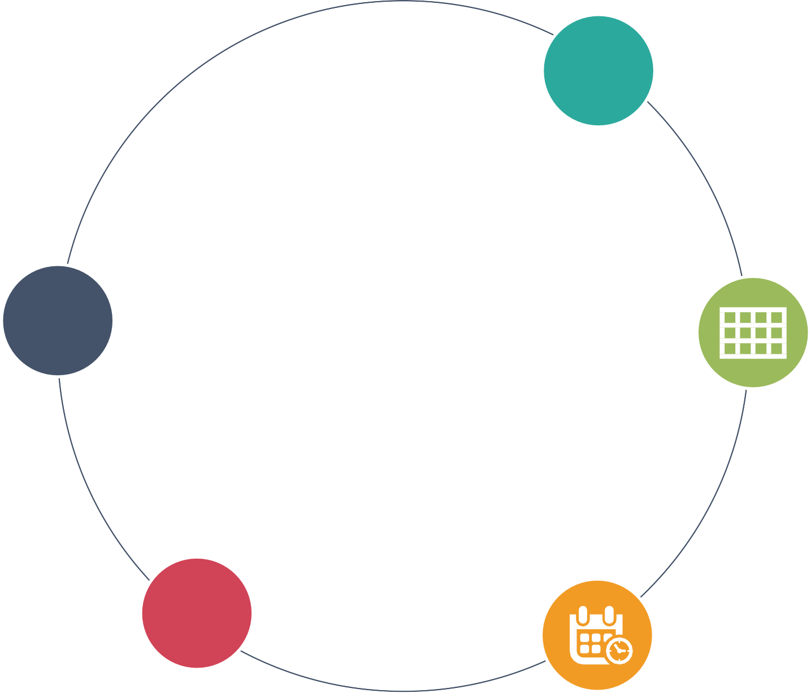
Data Types
Geographic values: Fields that contain names of cities, states, countries or latitude and longitude information are
considered Geographic.
Example: Texas, USA
Text values: Alphanumeric data and
strings are Text data types.
Example: “Books,” “CA-2013-151654”
abc
Boolean values: Fields that contain T/F or 0/1 as the only sets are considered Boolean. (Supported for
relational data sources) Example: Current year 2017: True Current year 2016: False
All fields in a data source have a data type. The data type reflects the kind of information stored in that field.
Date values: Strings matching a date format are considered Dates. Example: “01/23/2015,” “Jan 2015”
Numerical values: Fields that contain Numeric data, including decimal numbers are considered Numerical data type.
Example: 34.56, 410
#
Date and Time values: Fields that contain date as well as Time information are considered Date and Time data type.
Example: “01/23/2015 4:54:00PM”

Slide 44
Data Roles
In addition to a data type, every field in Tableau Public is characterized by two important settings that determine the behavior of the field when it is placed on a shelf:
Dimension vs. Measure
Discrete vs. Continuous
Varying the data roles can result in varying visualization.

Slide 45
Dimension vs. Measure
Dimension
Measure
Dimensions typically produce headers when added to the rows or columns shelves in the view.
By default, Tableau treats any field containing categorical information as a dimension.
Measures typically produce axes when added to the rows or columns shelves.
By default, Tableau treats any field containing numeric (quantitative) information as a measure.

Slide 46
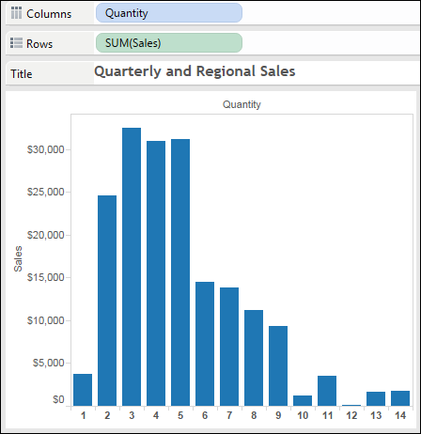
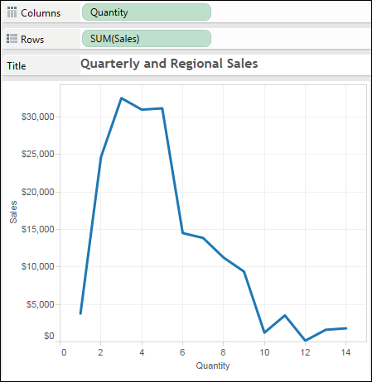
Continuous vs. Discrete
In addition to dimensions and measures, each field is categorized as either discrete or continuous.
The graphs below illustrate the differences between these two data roles.
Quantity as a Discrete Measure
Quantity as a Continuous Measure
The Quantity field is blue in the Columns shelf.
The Quantity field is green in the Columns shelf.
The quantity values are drawn along a continuous axis along the bottom of the line chart.
Each distinct quantity is displayed as a header along the bottom of the bar chart.

Slide 47
Introduction to Tableau Interface
Topic 4: Automatically Generated Fields in Tableau
Measure values and Measure names
Number of records measure
Visual cues for fields

Slide 48
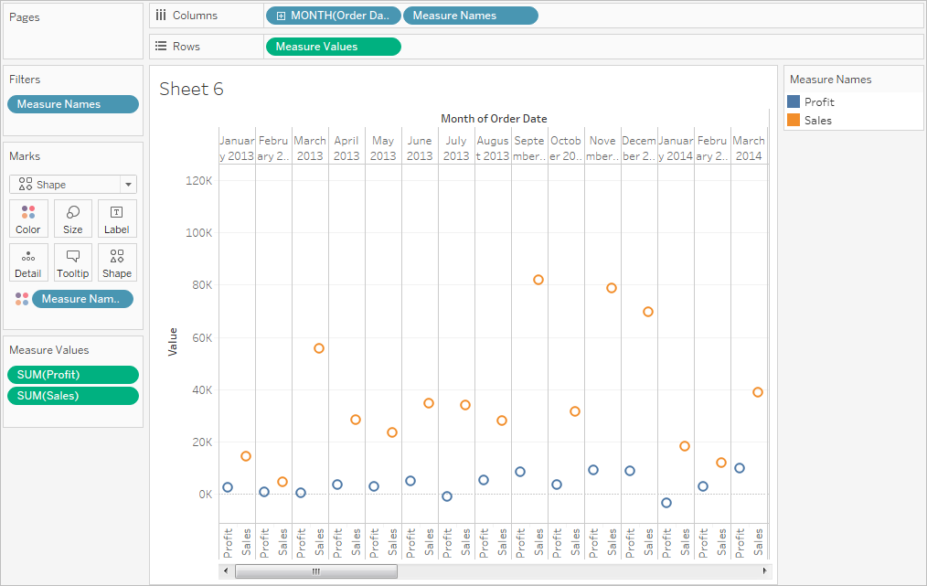

Additional Fields in the Data Pane
The Tableau data pane contains a number of fields that do not come from your original data. They are automatically generated by Tableau.
Two of the important fields are: Measure Values and Measure Names.
 | Date | Region | Sales | Profit
1 | 1/1/2005 | East | $ 100 | $ 50
2 | 1/2/2005 | West | $ 300 | $ 100
3 | 1/3/2005 | Central | $ 500 | $ 200
4 | 1/4/2005 | East | $ 400 | $ 160
5 | 1/5/2005 | South | $ 600 | $ 500
6 | 1/6/2005 | West | $ 800 | $ 750
7 | 1/7/2005 | West | $ 400 | $ 250
8 | 1/8/2005 | Central | $ 100 | $ 65
9 | 1/9/2005 | East | $ 300 | $ 254
Measure values appear at the bottom of the measures area. It contains all measures in the data collected into a single field with continuous values.

Slide 49
Additional Fields in the Data Pane
The Tableau data pane contains a number of fields that do not come from your original data. They are automatically generated by Tableau.
Two of the important fields are: Measure Values and Measure Names.
Date Region Sales Profit
1 1/1/2005 East $ 100 $ 50
2 1/2/2005 West $ 300 $ 100
3 1/3/2005 Central $ 500 $ 200
4 1/4/2005 East $ 400 $ 160
5 1/5/2005 South $ 600 $ 500
6 1/6/2005 West $ 800 $ 750
7 1/7/2005 West $ 400 $ 250
8 1/8/2005 Central $ 100 $ 65
9 1/9/2005 East $ 300 $ 254
Measure names appear at the bottom of the dimension area.
It contains names of all measures in the data collected in the single fields with discrete values.

Slide 50
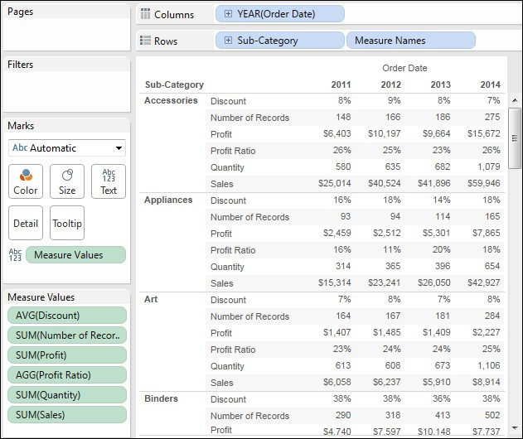
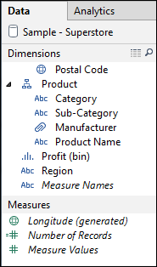
Using Measure Values and Measure Names
The image illustrates where Measure Names and Measure Values fields in a view are used.

Slide 51
Number of Records Measure
The number of records field is another field automatically created by Tableau for each data source added.
It is not a part of the underlying data.
It represents the number of rows in the data source.
It can prove more useful with categorical data
+
Abc

Slide 52
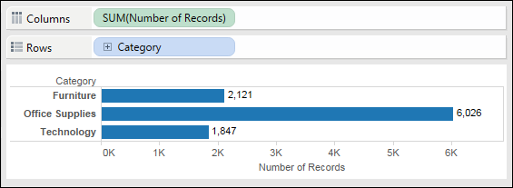
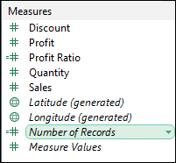
Using the Number of Records Measure
The image illustrates where the number of records field is used to analyze the total orders placed for each product category.

Slide 53





Visual Cues for Fields
Tableau provides many visual cues to help you evaluate the type of data displayed in the rows or columns shelves:
Icon | Description
 | The field is a level in a multidimensional hierarchy.
 | The field is blended with a field from another data source.
 | The field is a user filter and used when publishing to the web.
Region | A gray field on the Filters shelf indicates a context filter.
SUM(Sales) | The arrow icon indicates that a forecast is being displayed for the field.
Status | The field is from a secondary data source.
Internet Sales Amount | The field is incompatible with one or more other fields in the view.
MySet | The Venn diagram icon indicates a set.
MySet | A field name shown in italics indicates a filtered set.

Slide 54


Use Case 1
Genelia wants to design a discount strategy to increase sales. For this, she needs to analyze the quantity sold as a dimension to compare it against the sales trend.
Let’s understand this through a demonstration.

Slide 55
Demo—Changing Data Roles
Demonstrate how to convert the quantity measure to a dimension and convert the quality dimension from discrete to continuous and create a bar chart displaying sales by quantity

Slide 56



Closing Tableau Application
One of the following methods can be used to close Tableau application:
Select File
Click the Close icon located in the right corner of the application title bar
OR
Close

Slide 57
QUIZ

Slide 58


QUIZ
1
Which of the following is NOT a part of the data source page?
a.
Preview pane
b.
Join area
c.
Toolbar
d.
Metadata area

Slide 59

QUIZ
1
Which of the following is NOT a part of the data source page?
a.
Preview pane
b.
Join area
c.
Toolbar
d.
Metadata area
The correct answer is c.
Toolbar is a part of the Tableau workspace.

Slide 60
QUIZ
2
In the Tableau workspace, the sheet tabs are arranged at the .
a.
top
b.
bottom
c.
left
d.
right

Slide 61
QUIZ
2
In the Tableau workspace, the sheet tabs are arranged at the .
a.
top
b.
bottom
c.
left
d.
right
The correct answer is b.
In the Tableau workspace, the Sheet tabs are arranged at the bottom.

Slide 62
QUIZ
3
What does a red chain link visual cue represent?
a. The field is blended with a field from another data source.
b.
The field is linked to a website.
c.
The dimension is linked to a measure in the same data source.
d.
The dimension is linked to another dimension in the same data source.

Slide 63
QUIZ
3
What does a red chain link visual cue represent?
a. The field is blended with a field from another data source.
b.
The field is linked to a website.
c.
The dimension is linked to a measure in the same data source.
d.
The dimension is linked to another dimension in the same data source.
The correct answer is a.
The red chain link icon means that the field is (or can be) blended with a field from another data source.

Slide 64

Guided Exercise

Slide 65
Guided Exercise 1—Problem Statement
Genelia has to design an advertising campaign for certain product categories across various regions. First, she has to analyze how each of the product categories is performing in different regions. For this, she needs to create a bar in the bar chart that shows the sales values for each product category across various regions. Using the Sample-Superstore saved data source, create a worksheet and answer the following questions:
Which product category has the highest sales in the East region?
Which region recorded the lowest sales of office supplies?

Slide 66
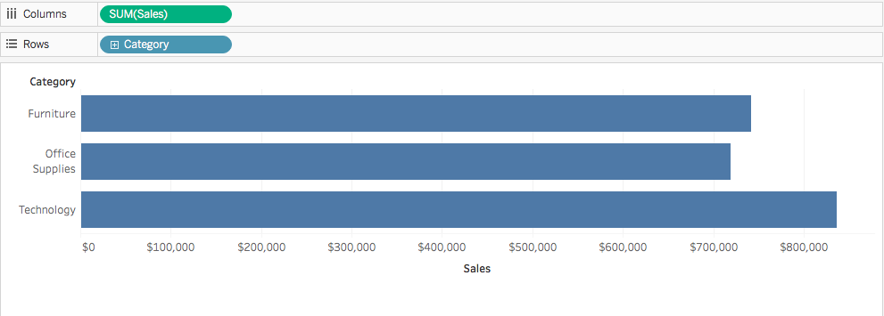
Guided Exercise 1—Solution
A
First, Genelia creates a bar chart showing sales by category:

Slide 67
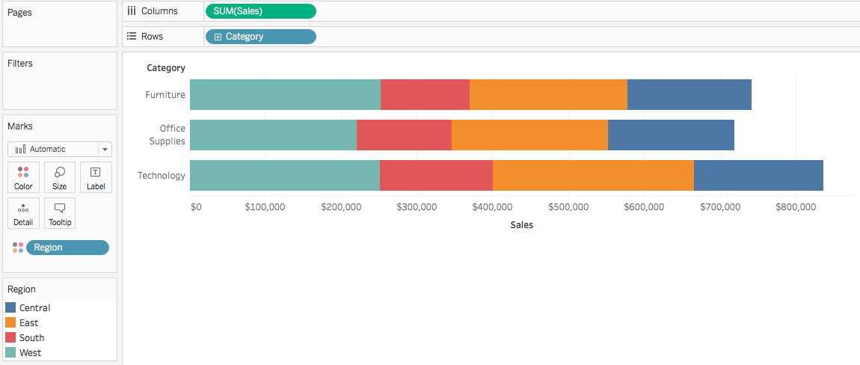
Guided Exercise 1—Solution
A
Then, Genelia adds the Region dimension using different colors to create the bar in bar chart:

Slide 68


Key Takeaways
The start page in Tableau Public is a central location from which you can connect to your data.
The Data Source page is used to make changes to the Tableau data sources.
The Tableau workspace consists of menus, a toolbar, the data pane, cards, shelves, and one or more sheets.
Text, Date, Date-Time, and Numeric are some of the data types supported by Tableau.
Data roles depict the behavior of the fields in the view. Visual cues help us evaluate the type of data displayed.

